Slide 1
EDA Pfizer Vaccine Tweets
BY : HALA ALENAZI
AS PROJECT 1 OF SDAIA DATA SCIENCE BOOTCAMP ( T5 )

Slide 2
Outlines
TOOLS
DATASET
RESULTS
WORK FLOW
Challenges
BACKSTORY

Slide 3
WORK FLOW
Problem understanding
Data
collection
Data
cleaning
Explore data
Finding
and insights

Slide 4
BACKSTORY
In those days, the world's interest was about Corona, and they were and are still afraid of vaccines, so social networking sites, especially Twitter, helped to know people's opinions about the vaccine , using the dataset I have from Kaggle I am planning to know more about Pfizer vaccine , does people shoed an interest in it ? the people who are posting about it does those people real or fake accounts ? which country shoed an interest in Pfizer ? people are posting using which devices and did the followers showed an interest in those tweets ?

Slide 5
DATASET
Data from Kaggle
version 140 , It was from 21-12-2020 to 21-10-2021
containing 10847 rows and 16 columns.

Slide 6
Challenges!
Understanding the data
delete columns
delete row
null values

Slide 7
TOOLS
Technologies
Jupyter Notebook
PowerPoint
Python
Libraries
Numpy Seaborn
Pandas Warnings
Matplotlib Counter

Slide 8
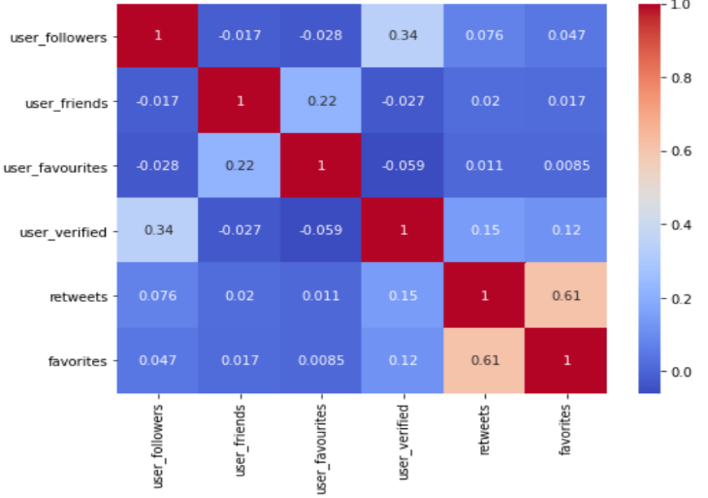
RESULTS
Find Correlation
the more retweets the more favorites
most of the people is not interested in vaccine

Slide 9
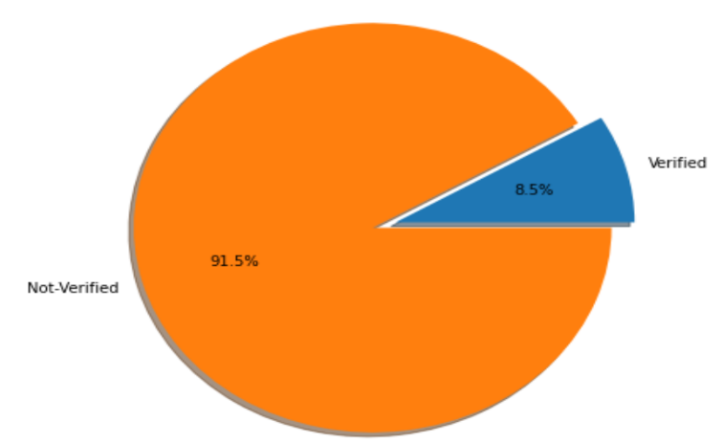
RESULTS
Most of published accounts are not verified .

Slide 10
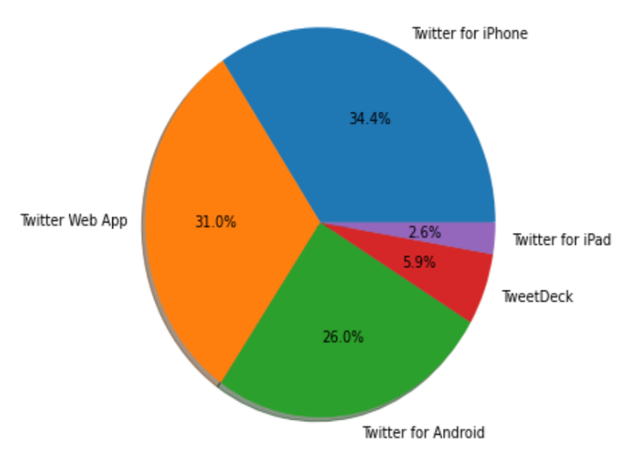
RESULTS
Top 5 Sources (Platform) of tweets
most of people tweets from iPhone devices

Slide 11
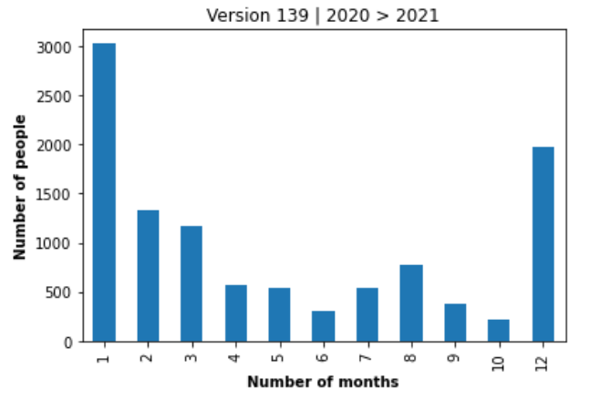
RESULTS
The study was from 12-21-2020 to 10-21-2021

Slide 12
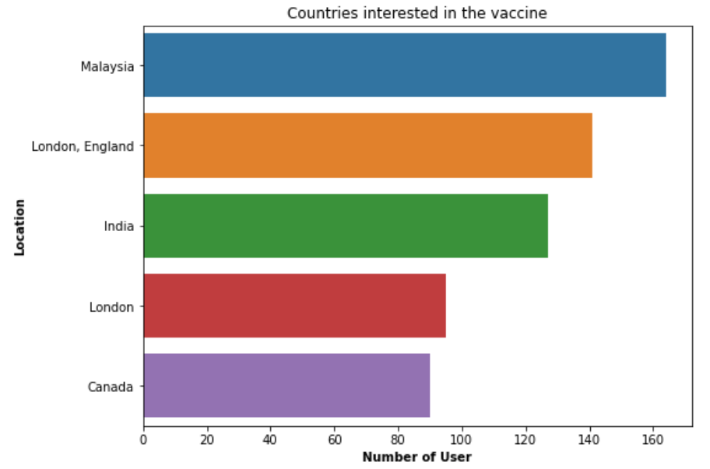
RESULTS
locations with most number of users tweets

Slide 13
THANK YOU FOR LISTINING !

